Slide 1



23 / 04
2024
Tim Spieringhs
Disassembly project

Slide 2

HTES
Lectoraat High Tech Embedded Software
TQ
Research focused and working closly with other companies

Slide 3
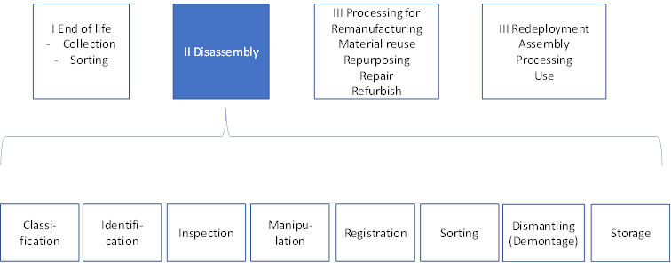
Project

Slide 4
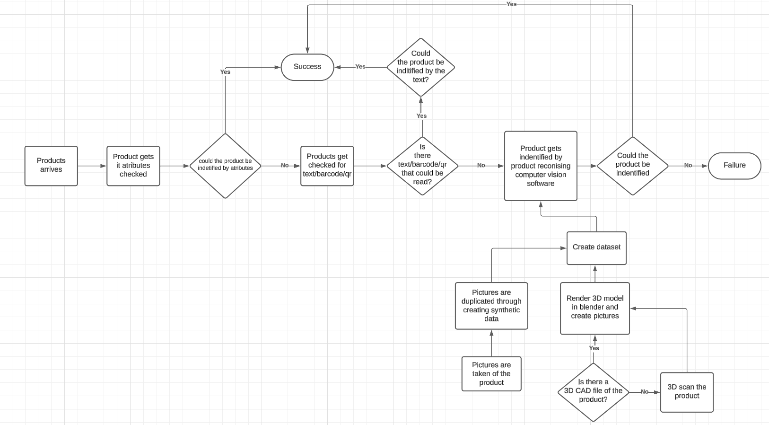
Project

Slide 5
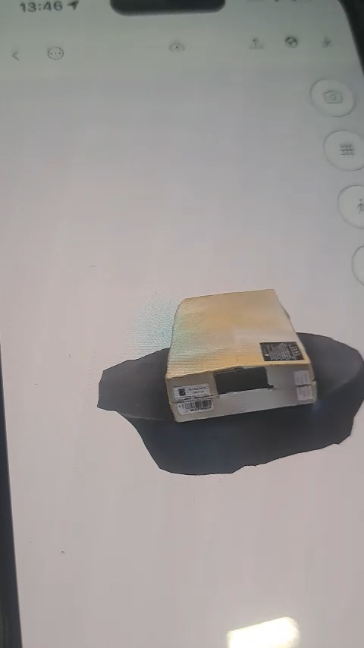
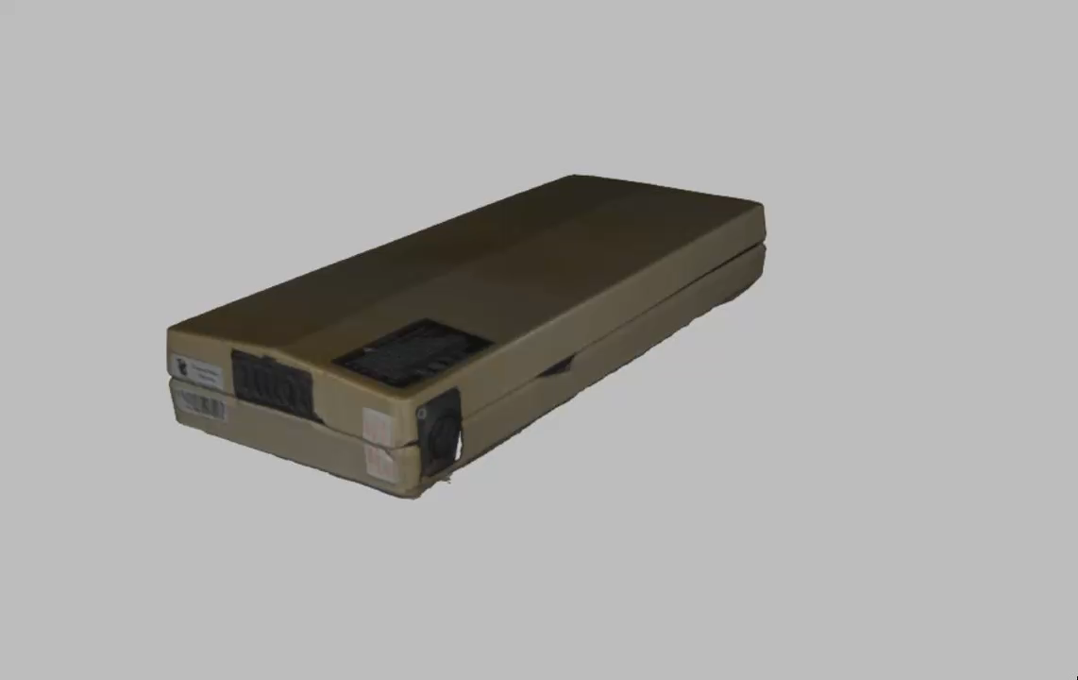
3D Scanning

Slide 6
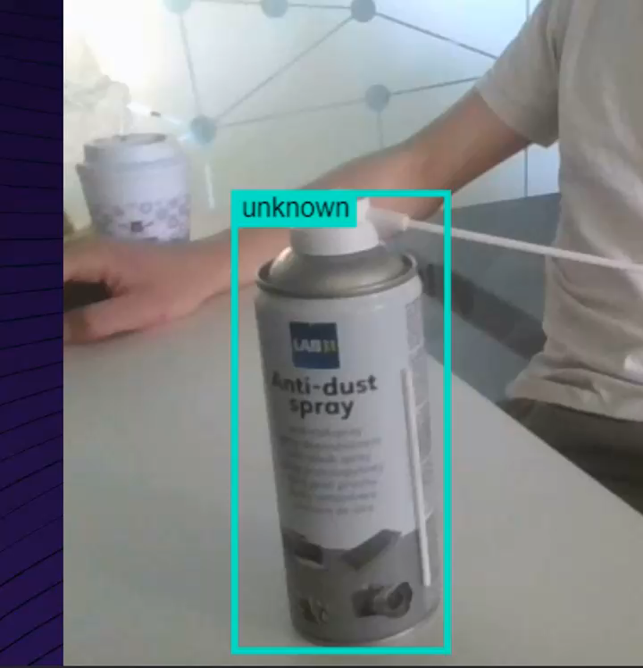
Dataset
Goal is to make this completly automatic and time efficient

Slide 7
Companies + Research
Working close with mulitple companies
Research big part of the project
Frameworks, algoritms and ways of detection need to be researched

